Slide 1
Design for Verification Project Update
2021-02-22
Eldrick Millares, Jack Humphries (eldrick, jhumphri@stanford.edu)

Slide 2
Tasks Completed
Typeset Proof Sketch
Re-examine Processor Simplifications in VScale
CSR Registers disabled
Memory Load / Store disabled
Multiplication and division are enabled
Branching disabled
Discussion on Proof Sketch
Last Tuesday w Florian / Jack / Caroline / Eldrick
Outstanding questions about scope of proof

Slide 3
Tasks In Progress - Re-embedding Proof Sketch
Re-embedding within FMCAD ‘20 definitions and framework
Eldrick: Fitting FMCAD “Bug” definition to proof sketch
Florian: Bug Model / Bug Triggering visual guide

Slide 4
Tasks In Progress - Re-examining Proof Sketch
Does not address interaction between arch and u-arch state

Slide 5
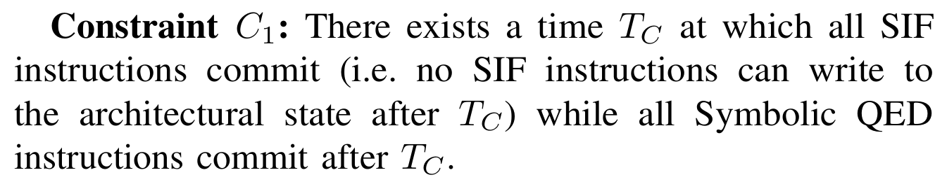
Current Proof Sketch

Slide 6
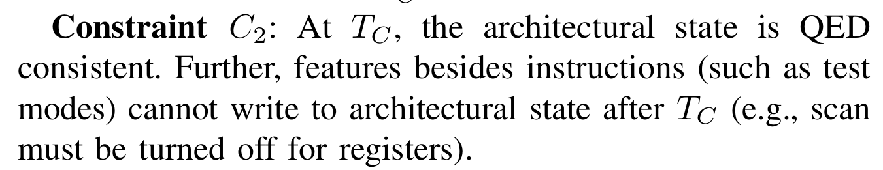
Current Proof Sketch

Slide 7
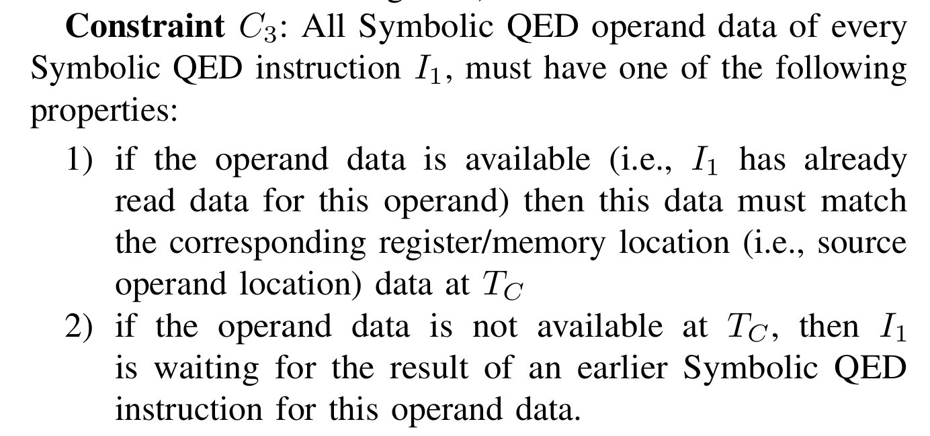
Current Proof Sketch

Slide 8
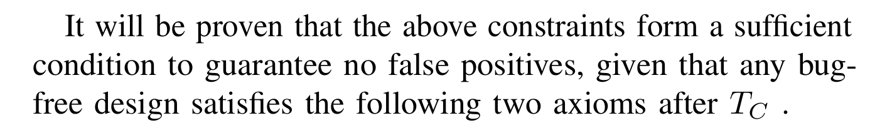
Current Proof Sketch

Slide 9
Current Proof Sketch
Axiom 1 “When a Symbolic QED instruction executes twice on the same data, then it should result in the same outputs.”

Slide 10
Current Proof Sketch
Axiom 2 “When any operand of a Symbolic QED instruction has RAW dependency with any earlier Symbolic QED instruction(s), it should obtain the correct source value” … “When an operand of a Symbolic QED instruction does not have dependencies with earlier Symbolic QED instructions, it obtains the correct source value from the architectural state at time T_{C} “

Slide 11
Question - Unaddressed Microarchitectural State
Processor design could meet all constraints and axioms but still be subject to spurious counterexamples.
Example: Unreachable Counter Value in Ticking Timebomb Trojan

Slide 12
Example: Unreachable Counter Value
Previously brought up 3 weeks ago in Eldrick’s Ticking Timebomb Trojan Examples

Slide 13
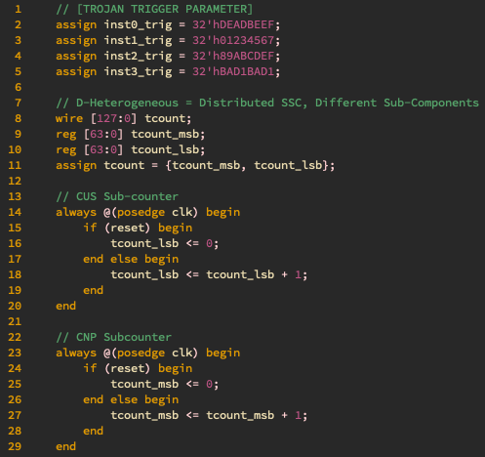
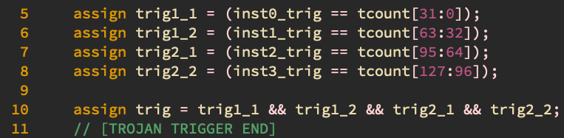
Trigger consists of different values for MSBs/LSBs
2) The MSBs and LSBs update in lockstep. They cannot trigger the payload from reset 3) But assertion is violated
Notes:
MSB <> LSB [0][1] [1][0] tcount _lsb = 00
tcount_msb = 00

Slide 14
Example: Unreachable Counter Value
Simpler Example: Counter resets to 0 before it reaches trigger value

Slide 15
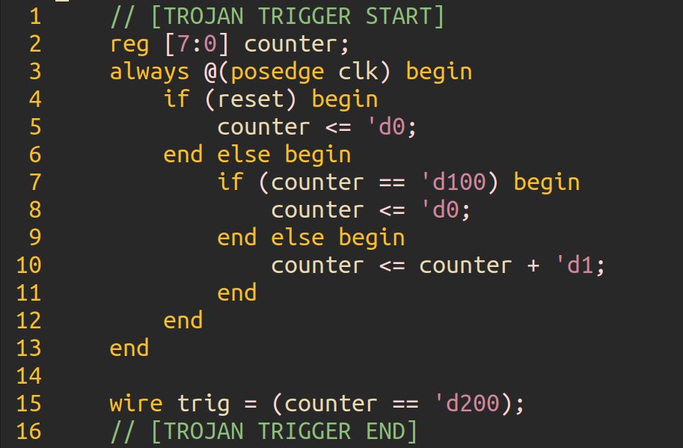
Example: Unreachable Counter Value - Simple

Slide 16
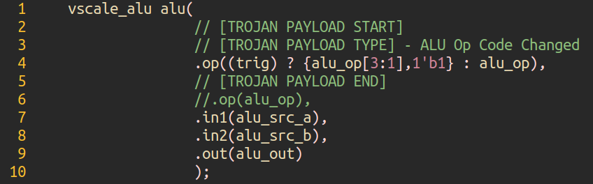
Example: Unreachable Counter Value - Simple

Slide 17
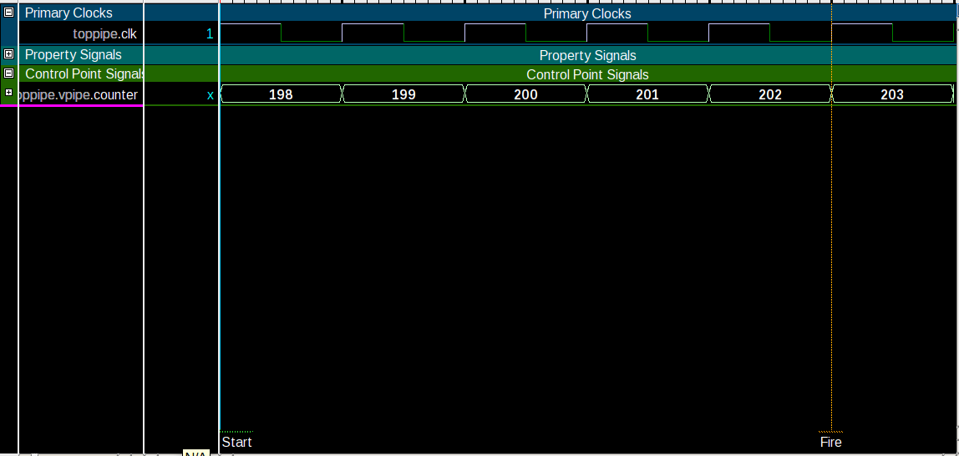
Example: Unreachable Counter Value - Violation

Slide 18
Question - Stateful Instructions / Sequential Circuits
How to account for rdtsc Instruction in SQED?

Slide 19
In Progress - Processor Simplification Analysis
In current vscale demo, the following features are disabled:
CSR Registers
Memory Load & Store

Slide 20
Tasks Planned
Meeting with Shashank
Is this possible?
Best person to contact through?
Explore strategies to address proof sketch deficiencies
Coppelia’s Backtracking Approach
Soft / Hard Resets proposed in Lonsing et al. FMCAD ‘20 (soundness)
?
Disable simplifications in RideCore / vscale

Slide 21
Appendix
(Courtesy of Florian Lonsing)

Slide 22
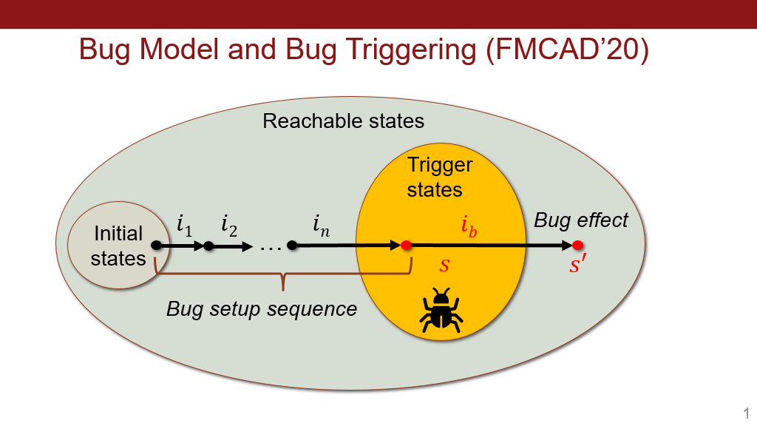

Slide 23
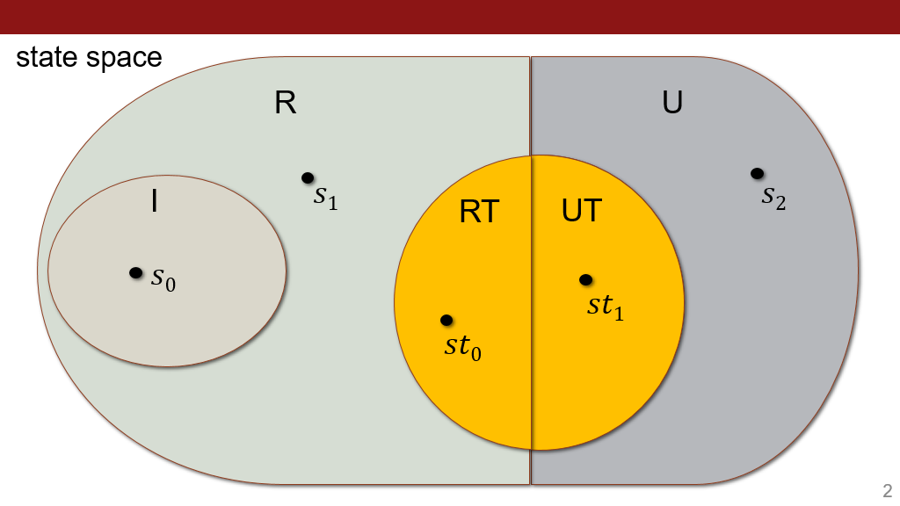

Slide 24
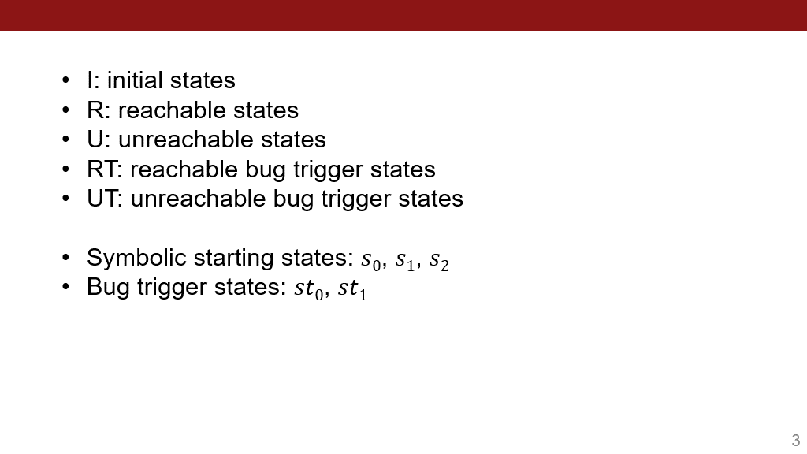

Slide 25
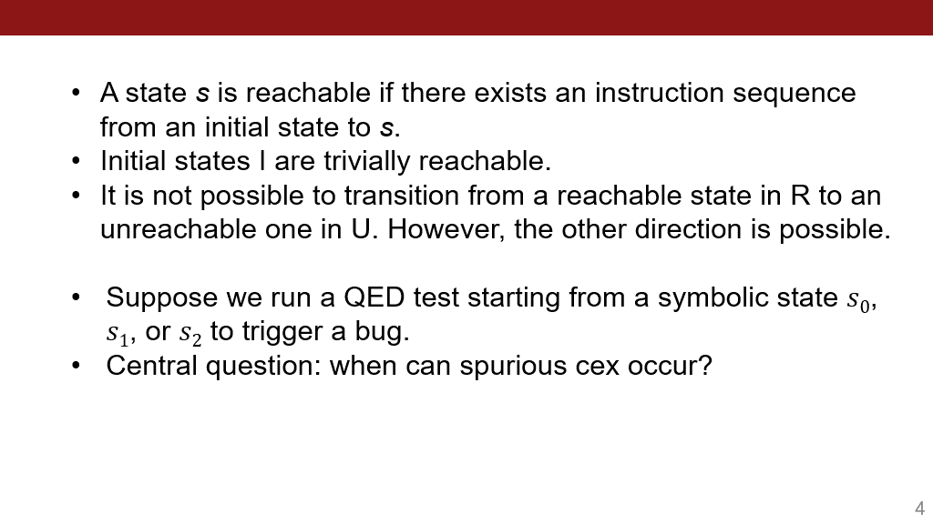

Slide 26
